Slide 1
神公义的审判 god’s Righteous judgment
徐志雄
joe Xu

Slide 2
人的败坏 Human depravity
原来，神的忿怒从天上显明在一切不虔不义的人身上，就是那些行不义阻挡真理的人。（罗马书1:18）
The wrath of God is being revealed from heaven against all the godlessness and wickedness of people, who suppress the truth by their wickedness （Romans1:18）

Slide 3
罗马书 romans 1:26-27
因此，神任凭他们放纵可羞耻的情欲。他们的女人把顺性的用处变为逆性的用处；男人也是如此，弃了女人顺性的用处，欲火攻心，彼此贪恋，男和男行可羞耻的事，就在自己身上受这妄为当得的报应。Because of this, God gave them over to shameful lusts. Even their women exchanged natural sexual relations for unnatural ones. In the same way the men also abandoned natural relations with women and were inflamed with lust for one another. Men committed shameful acts with other men and received in themselves the due penalty for their error.

Slide 4
罗马书 romans 1:32
他们虽知道神判定行这样事的人是当死的，然而他们不但自己去行，还喜欢别人去行。
Although they know God’s righteous decree that those who do such things deserve death, they not only continue to do these very things but also approve of those who practice them.

Slide 5
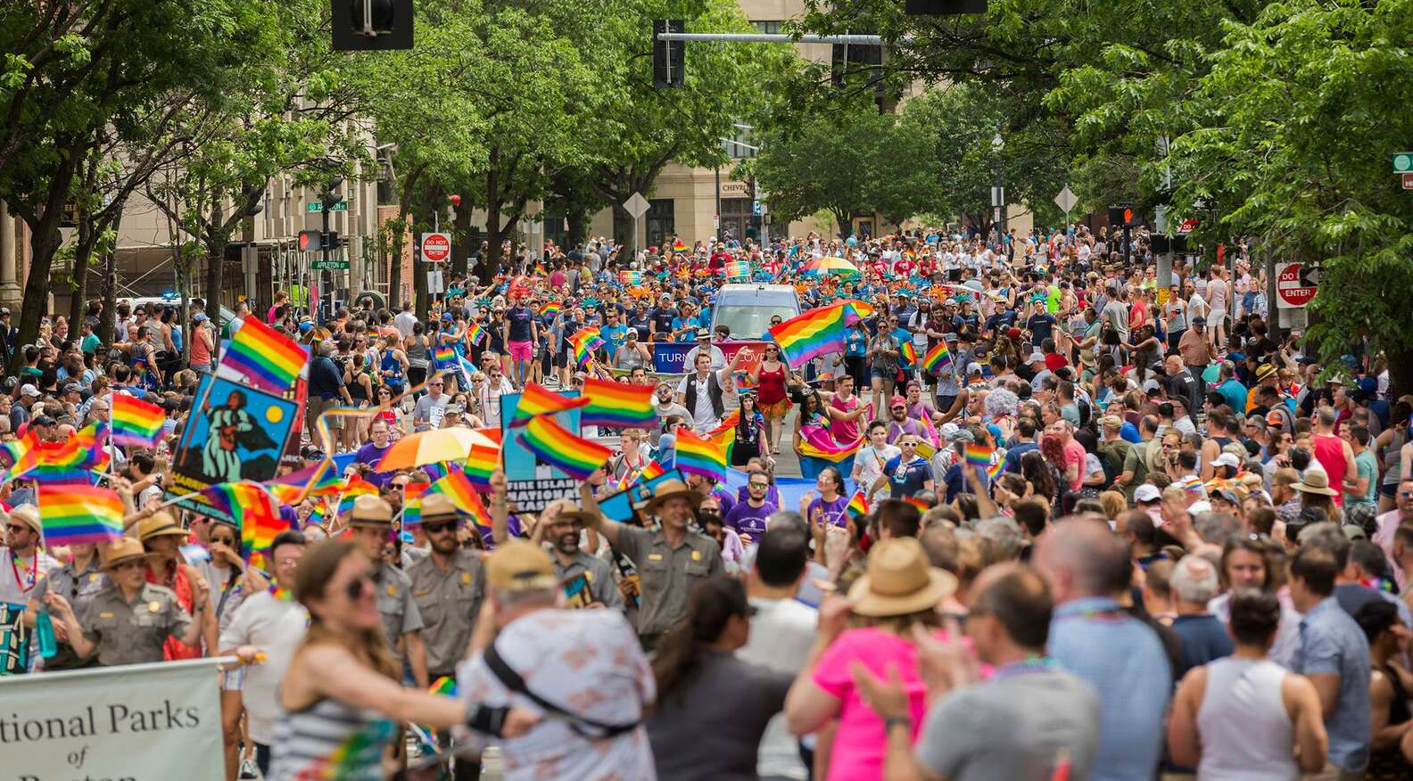

Slide 6
一、论断 judgment
你这论断人的 ，无论你是谁，也无可推诿。你在甚么事上论断人，就在甚么事上定自己的罪；因你这论断人的，自己所行却和别人一样。(罗马书 2:1）
You, therefore, have no excuse, you who pass judgment on someone else, for at whatever point you judge another, you are condemning yourself, because you who pass judgment do the same things. (Romans 2:1)

Slide 7
一、论断 judgment
你这论断人的 ，无论你是谁，也无可推诿。你在甚么事上论断人，就在甚么事上定自己的罪；因你这论断人的，自己所行却和别人一样。(罗马书 2:1）
You, therefore, have no excuse, you who pass judgment on someone else, for at whatever point you judge another, you are condemning yourself, because you who pass judgment do the same things. (Romans 2:1)

Slide 8
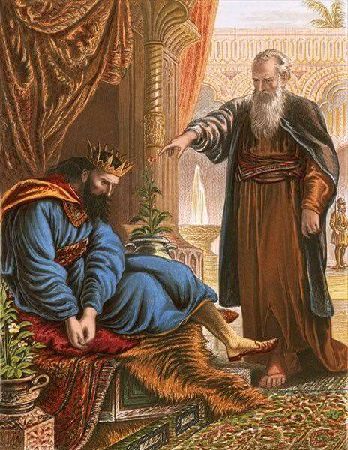

Slide 9
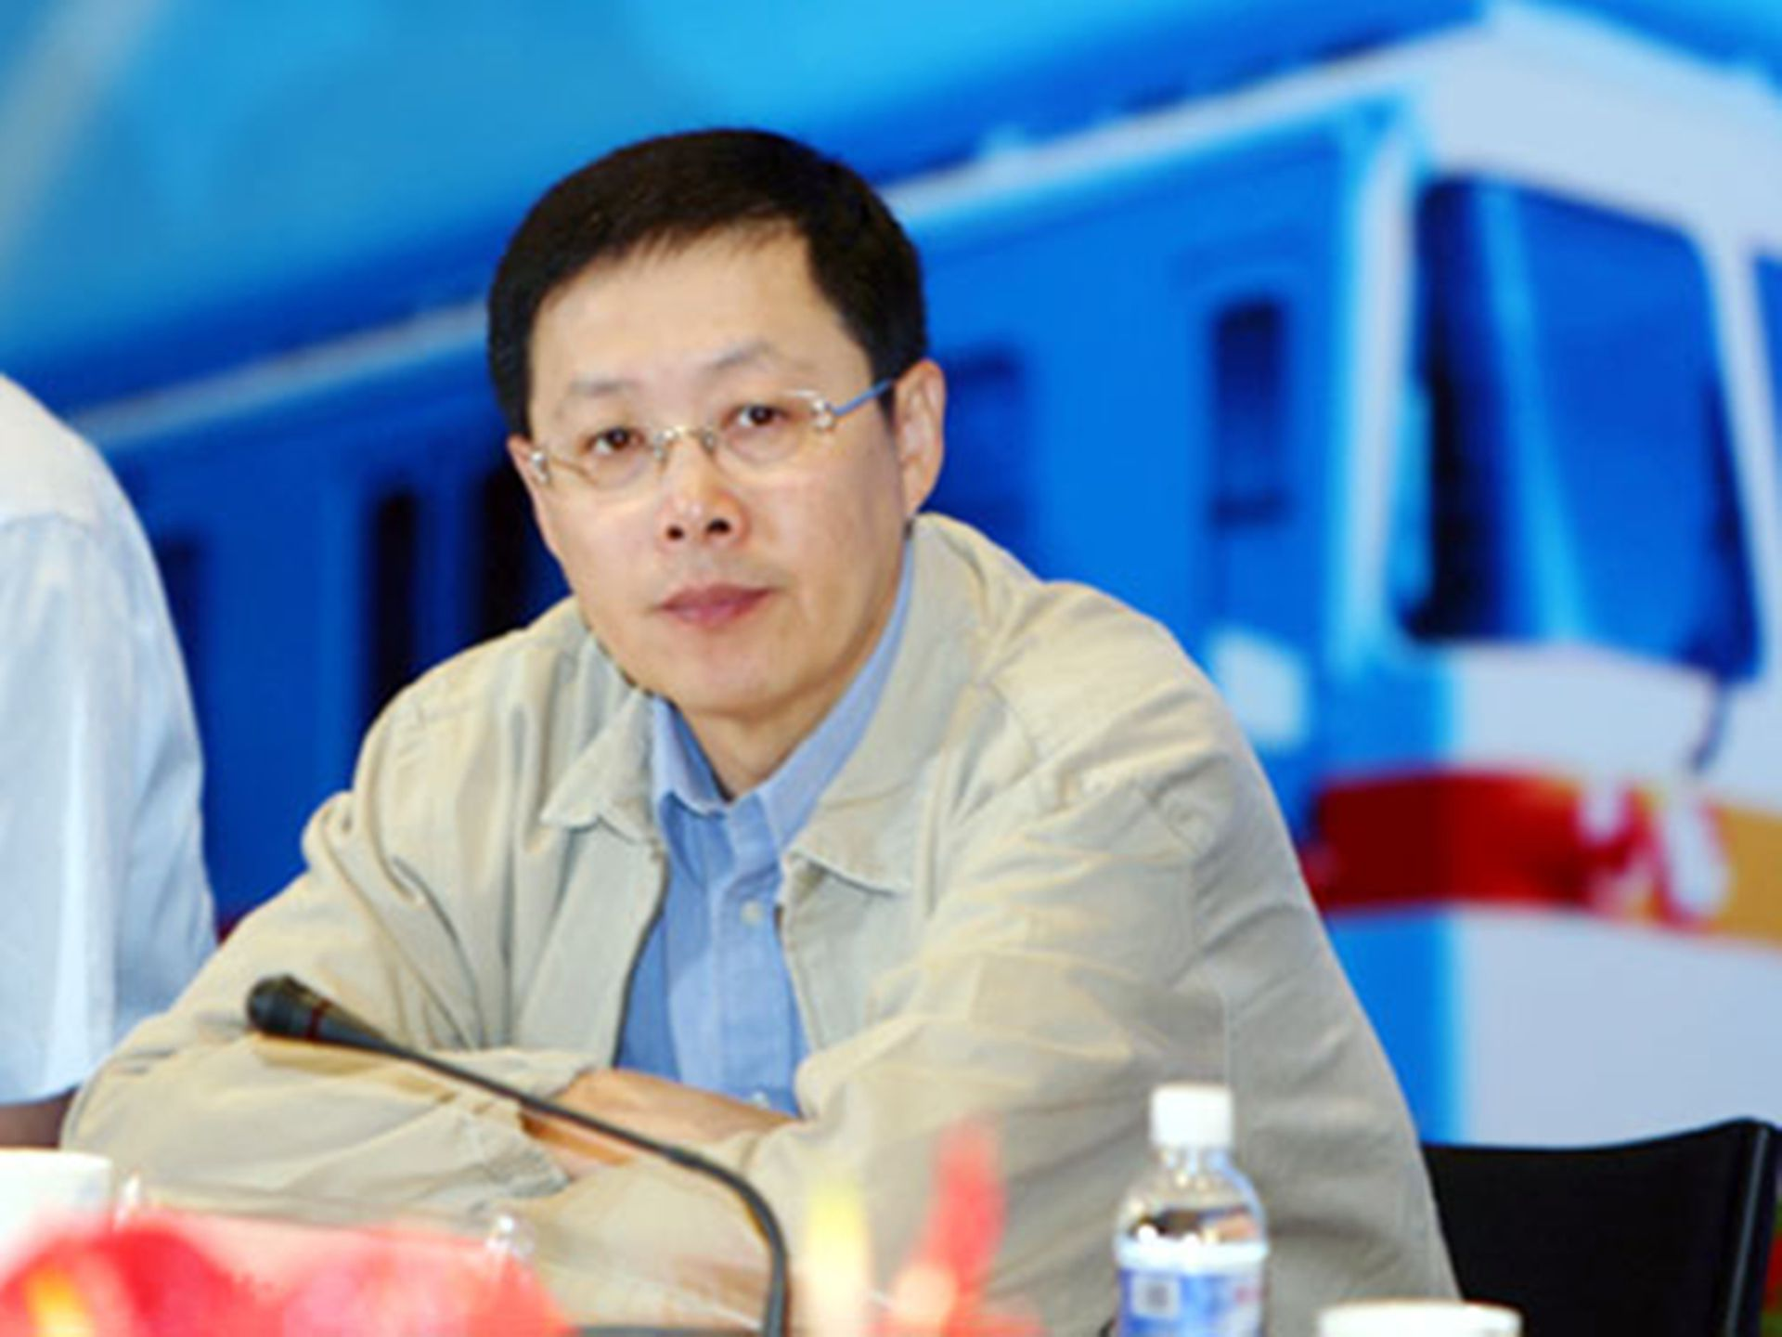

Slide 10
一、论断 judgment
你竟任着你刚硬不悔改的心，为自己积蓄忿怒，以致神震怒，显他公义审判的日子来到。(罗马书 2:5）
But because of your stubbornness and your unrepentant heart, you are storing up wrath against yourself for the day of God’s wrath, when his righteous judgment will be revealed. (Romans 2:5)

Slide 11
二、他必报应 he will repay
他必照各人的行为报应各人。 (罗马书 2:6)
God “will repay each person according to what they have done.” (Romans 2:6)

Slide 12
雅各书 james 2:17-18
信心若没有行为就是死的。。。你将你没有行为的信心指给我看，我便藉着我的行为，将我的信心指给你看。
... Faith by itself, if it is not accompanied by action, is dead. ... Show me your faith without deeds, and I will show you my faith by my deeds

Slide 13
他们的追求目标 The Goal
凡恒心行善、寻求荣耀、尊贵和不能朽坏之福的，就以永生报应他们；惟有结党、不顺从真理、反顺从不义的，就以忿怒、恼恨报应他们 (罗马书 2:7-8）
To those who by persistence in doing good seek glory, honor and immortality, he will give eternal life. But for those who are self-seeking and who reject the truth and follow evil, there will be wrath and anger.

Slide 14
他们的行为模式 The ACT
凡恒心行善、寻求荣耀、尊贵和不能朽坏之福的，就以永生报应他们；惟有结党、不顺从真理、反顺从不义的，就以忿怒、恼恨报应他们 (罗马书 2:7-8）
To those who by persistence in doing good seek glory, honor and immortality, he will give eternal life. But for those who are self-seeking and who reject the truth and follow evil, there will be wrath and anger.

Slide 15
他们的行为模式 The End
凡恒心行善、寻求荣耀、尊贵和不能朽坏之福的，就以永生报应他们；惟有结党、不顺从真理、反顺从不义的，就以忿怒、恼恨报应他们 (罗马书 2:7-8）
To those who by persistence in doing good seek glory, honor and immortality, he will give eternal life. But for those who are self-seeking and who reject the truth and follow evil, there will be wrath and anger.

Slide 17
三、他不偏待人 No favoritism
因为神不偏待人。 （罗马书2:11）
For God does not show favoritism. (Romans 2:11)

Slide 18
四、听律法的 vs 行律法的
Hear the Law vs Obey the Law
凡没有律法犯了罪的，也必不按律法灭亡；凡在律法以下犯了罪的，也必按律法受审判。（罗马书2:12）
All who sin apart from the law will also perish apart from the law, and all who sin under the law will be judged by the law. (Romans 2:12)

Slide 19
原来在神面前，不是听律法的为义，乃是行律法的称义。 （罗马书2:13）
For it is not those who hear the law who are righteous in God’s sight, but it is those who obey the law who will be declared righteous. (Romans 2:13)

Slide 20
没有律法的外邦人若顺着本性行律法上的事，他们虽然没有律法，自己就是自己的律法。这是显出律法的功用刻在他们心里，他们是非之心同作见证，并且他们的思念互相较量，或以为是，或以为非.（罗马书2:14-15）
Indeed, when Gentiles, who do not have the law, do by nature things required by the law, they are a law for themselves, even though they do not have the law. They show that the requirements of the law are written on their hearts, their consciences also bearing witness, and their thoughts sometimes accusing them and at other times even defending them.

Slide 21
律法的功用 The requirements of the law
道德律 Moral Law ——十诫 The Ten Commandments
民事律 Civil Law——爱邻舍 Love Your Neighbors
宗教律 Religious Law——敬拜神 Worship God

Slide 22
没有律法的外邦人若顺着本性行律法上的事，他们虽然没有律法，自己就是自己的律法。这是显出律法的功用刻在他们心里，他们是非之心同作见证，并且他们的思念互相较量，或以为是，或以为非.（罗马书2:14-15）
Indeed, when Gentiles, who do not have the law, do by nature things required by the law, they are a law for themselves, even though they do not have the law. They show that the requirements of the law are written on their hearts, their consciences also bearing witness, and their thoughts sometimes accusing them and at other times even defending them.

Slide 23
良心的功用 Functions of Conscience
光照，会分辨，会警戒 Enlighten, Discern, Warn
沉睡 Sleep
鉴察，会控告 Inspect, Accuse
作见证 Witness

Slide 24
到审判的日子，神要问我们。。。 On The Judgment Day, God Will Ask ...
是否在恶事上不但自己去行，还喜欢别人也去行
Do you not only continue to do the bad things but also approve of those who practice them?
是否论断别人，而自己所行的却和别人一样
Do you pass judgment on others and yet do the same things?

Slide 25
到审判的日子，神要问我们。。。 On The Judgment Day, God Will Ask ...
是否恒心行善，寻求荣耀尊贵和不能朽坏之福
Do you seek glory, honor and immortality by persistence in doing good?
是否只是听律法的，还是那个行律法的
Are you the one who hears the law, or the one who obeys the law?

