Slide 1
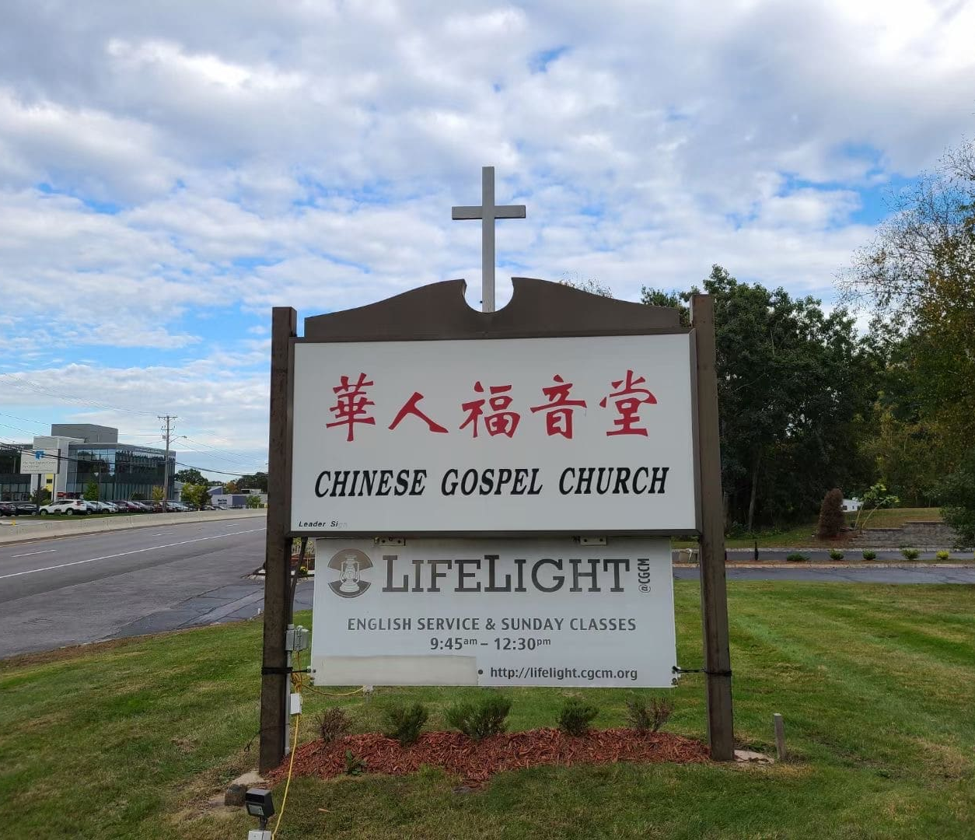
服事神的国度 Serving God’s Kingdom
CGCM
40th Celebration

Slide 2
神把教会设在地上，不是设在天上；把圣徒留在地上，没有提到天上；
God sets up His church on earth, not in heaven; He leaves His people here on earth, not up there in heaven!

Slide 3
明显地是要我们与这破碎，沉沦，罪恶的世界一同承担苦难 (这是十字架的真理)；
In order that we may partake in the hardship with this broken, fallen, sinful world (It is the way of the Cross);

Slide 4
并且藉此为神救赎的恩典与能力作见证，活出新创造在苦难中的盼望与忍耐。
Even as to testify to God’s grace and power of salvation; and live out the hope and endurance of the new creation in such hardship.

Slide 5
How do we make sure that we do not seek to be “successful” (in the eyes of the world), but to be “faithful” (in the eyes of the LORD) ?
我们如何能确定我们所追求的不是“成功”；而是“信实”?

Slide 6
这是谁的故事 – 是我们在神的故事中，还是我们只不过在自己的故事中加了神的微信?
Whose story is it – Are we in God’s story? Or are we merely putting God in our story?

Slide 7
耶穌進前來，對他們說：「天上地下所有的權柄都賜給我了。 所以，你們要去，使萬民作我的門徒，奉父、子、聖靈的名給他們施洗，凡我所吩咐你們的，都教導他們遵守。看哪，我天天與你們同在，直到世代的終結。」
马太福音 28:18-20

Slide 8
“ And Jesus came up and spoke to them, saying, “All authority in heaven and on earth has been given to Me. Go therefore and make disciples of all the nations, baptizing them in the name of the Father and the Son and the Holy Spirit, teaching them to observe all that I commanded you; and lo, I am with you always, even to the end of the age.” Matthew 28:19-20 (NASB)

Slide 9
Be Specific 要確實 – what’s so special about CGCM?
我们的特点在哪里?

Slide 10
我們的DNA
地理位置 Geographic location
新人特色 Young Families
會友背景 Intellectual Elites
團隊操作 Teamwork

Slide 11
Our Convictions:
God has provided the church with a great location, ample space, and many capable leaders and workers. We need to serve the Kingdom with these gifts – to host, to teach and preach, to manage property, to serve the community…

Slide 12
A Tentative Building Plan?
從工作到工人 From Works to Workers
從信徒到門徒 From Fellowship to Discipleship
從信心到信實 From Faith to Faithfulness
從異象到使命 From Vision to Mission
從榮耀到榮耀 From Glory to Glory

Slide 13
Be Intentional 要主動 – What kind of church culture to cultivate?
福音堂的文化特质?

Slide 14
Cultivation 深耕教會文化 – 1
We will take Bible study very seriously.
我們必須認真查經 (Ex. 北美華神的課程；王守仁教授講座)

Slide 15
Cultivation 深耕教會文化 – 2
We will exercise what we learn from the Bible in our daily life.
教會操作與日常生活必須遵守聖經原則

Slide 16
Cultivation 深耕教會文化 – 3
We will build a loving community – A Christ-like character reflected through Raymond and Ruth Wong
營造一個有愛心的群體

Slide 17
Cultivation 深耕教會文化 – 4
We will insist on accountability and transparency
我們要營造一個公開透明的教會 – 尤其是領導團隊

Slide 18
Cultivation 深耕教會文化 – 5
We will actively engage in Christian missions
我們要積極參與基督徒的宣教使命

Slide 19
談何容易啊！Easy? No!
就是因為不容易，才交付給我們做。
It wouldn’t be our job, if it were easy.

Slide 20
Be Focused 要聚焦 – Are we serving the Kingdom of God?
聚焦在神的国度?

Slide 21
在很多人的心理，教会是个社会福利机构(charity organization)；然而教会是神国度在地上的大使馆。
Many have looked to church as a charitable organization; and expect as much. Yet, Christ’s church are ambassy of God’s kingdom

Slide 22
如果我們是基督的使者，那麼我們應該要如何來服事祂的國度?
As ambassadors of Christ, how should church serve the Kingdom of God here on earth?

Slide 23
『所以，你們要去，使萬民作我的門徒，奉父、子、聖靈的名給他們施洗， 凡我所吩咐你們的，都教導他們遵守。看哪，我天天與你們同在，直到世代的終結。』
馬太福音 28:19-20 (和合本修訂版)

Slide 24
“Go therefore and make disciples of all the nations, baptizing them in the name of the Father and the Son and the Holy Spirit, teaching them to observe all that I commanded you; and lo, I am with you always, even to the end of the age.”
Matthew 28:19-20 (NASB)

Slide 25
為神的國度預備資源 Prepare the Way for the Kingdom
為神的國度造就門徒 Develop disciples for the Kingdom
為神的國度培訓工人 Train workers for the Kingdom
為神的國度籌募金錢 Raise money for the Kingdom

Slide 26
教会之间的合作 Foster Partnership with Area Churches
We are not competitors with area churches; we are team members.
我們是隊友；不是對手

Slide 27
Be Courageous 要有勇氣 – There is always the risk
刚强壮胆跟随主?

Slide 28
“我保證可以帶你進去，但不保證可以帶你出來…”
“I can get you in there, but I can’t guarantee that I’ll be able to get you out of there…”
Rev. Jonathan Chao 趙天恩牧師
1996

Slide 29
We have only one question: “Where are we needed?” 我们只问：哪里的需要才是用得上我们的地方?

Slide 30
使徒行傳 6:1 那时、门徒增多、有说希利尼话的犹太人、向希伯来人发怨言．因为在天天的供给上忽略了他们的寡妇…8:1 从这日起、耶路撒冷的教会、大遭逼迫．除了使徒以外、门徒都分散在犹太和撒玛利亚各处…4 那些分散的人、往各处去传道。

Slide 31
Acts 6:1 Now in these days when the disciples were increasing in number, a complaint by the Hellenists arose against the Hebrews because their widows were being neglected in the daily distribution… 8:1 …And there arose on that day a great persecution against the church in Jerusalem, and they were all scattered throughout the regions of Judea and Samaria, except the apostles… 4 Now those who were scattered went about preaching the word.

Slide 32
福音堂开始差派，值堂的时候，我们没有牧师，没有传道 – When we commissioned Ben & Catherine to China mission, and about 20 families to move west to Worcester in 1999…we didn’t even have a pastor then.

Slide 33
結語 Concluding Remarks
我们既然站在神的故事里面，又看到他的国度有许多的需要；让我们说：“我在这里，请差遣我”
As we stand in God’s story, and see many needs that we may be able to meet, let us say, “Here I am. Send me.”

