Slide 1
復活:神的精心傑作 Resurrection: God’s Masterpiece
以弗所書Ephesians 2:1-10

Slide 3
復活: 神的精心傑作 Resurrection: God’s Masterpiece

Slide 4
復活: 神的精心傑作 Resurrection: God’s Masterpiece
路加福音Luke15:32
只是你這個兄弟是死而復活、失而又得的，所以我們理當歡喜快樂。
It was fitting to celebrate and be glad, for this your brother was dead, and is alive; he was lost, and is found.

Slide 5
復活: 神的精心傑作
以弗所書2:1-10

Slide 6
以弗所書 2:1-2
¹ 你們死在過犯罪惡之中，祂叫你們活過來。² 那時你們在其中行事為人，隨從今世的風俗，順服空中掌權者的首領，就是現今在悖逆之子心中運行的邪靈。
And you were dead in the trespasses and sins ² in which you once walked, following the course of this world, following the prince of the power of the air, the spirit that is now at work in the sons of disobedience—

Slide 7
以弗所書 2:3
³ 我們從前也都在他們中間，放縱肉體的私慾，隨著肉體和心中所喜好的去行，本為可怒之子，和別人一樣。
³ among whom we all once lived in the passions of our flesh, carrying out the desires of the body and the mind, and were by nature children of wrath, like the rest of mankind.

Slide 8
我們死在過犯罪惡之中 We were dead (vv, 1-3)
主復活的必要 The Necessity of the Lord’s Resurrection (vv. 1-3)

Slide 9
以弗所書 2: 4-5
⁴ 然而，神既有豐富的憐憫，因祂愛我們的大愛， ⁵ 當我們死在過犯中的時候，便叫我們與基督一同活過來。你們得救是本乎恩。
⁴ But God, being rich in mercy, because of the great love with which he loved us, ⁵ even when we were dead in our trespasses, made us alive together with Christ—by grace you have been saved—

Slide 10
以弗所書 2: 6-7
⁶ 祂又叫我們與基督耶穌一同復活，一同坐在天上， ⁷ 要將祂極豐富的恩典，就是祂在基督耶穌裡向我們所施的恩慈，顯明給後來的世代看。
⁶ and raised us up with him and seated us with him in the heavenly places in Christ Jesus, ⁷ so that in the coming ages he might show the immeasurable riches of his grace in kindness toward us in Christ Jesus.

Slide 11
我們與基督一同活過來 We were raised from the dead with Christ (vv, 4-9)
主復活的真諦 The True Meaning of the Lord’s Resurrection (vv. 4-9)

Slide 12
以弗所書 2:10
¹⁰ 我們原是祂的工作，在基督耶穌裡造成的，為要叫我們行善，就是神所預備叫我們行的。
¹⁰ For we are his workmanship, created in Christ Jesus for good works, which God prepared beforehand, that we should walk in them.

Slide 13
我們成了神的精心傑作 We are God’s Masterpiece (v. 10)
主復活的結果 The Result of the Lord’s Resurrection (vv. 4-9)

Slide 14
復活: 神的精心傑作 Resurrection: God’s Masterpiece
我們死在過犯罪惡之中 We were dead (vv, 1-3)
我們與基督一同活過來 We were raised from the dead with Christ (vv, 4-9)
我們成了神的精心傑作 We are God’s Masterpiece (v. 10)

Slide 15
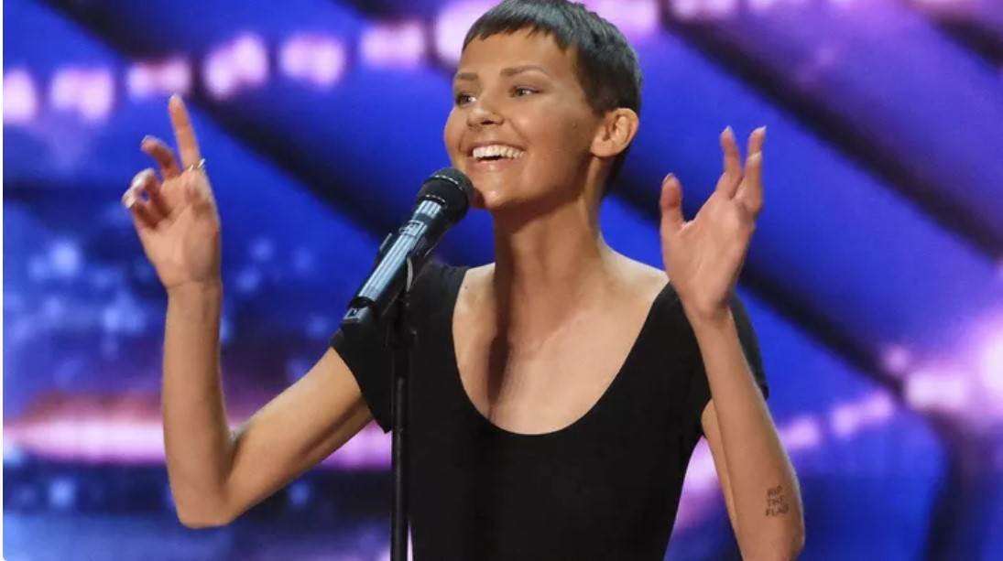
Jane Kristen Marczewski, Nightbirde

Slide 16
“Two percent is is not zero percent.
Two percent is something,
and I wish people knew how amazing it is.”
Jane Kristen Marczewski, Nightbirde (December 29, 1990 – February 19, 2022).

Slide 17
以弗所書 2:10
我們原是祂的工作，在基督耶穌裡造成的，為要叫我們行善，就是神所預備叫我們行的。
For we are his workmanship, created in Christ Jesus for good works, which God prepared beforehand, that we should walk in them.

Slide 18
因祂活著 Because He Lives

Slide 19
因祂活著，我能面對明天；
因祂活著，不再懼怕；
我深知道，祂掌管明天，
生命充滿了希望，只因祂活著。
Because He lives, I can face tomorrow, Because He lives, all fear is gone; Because I know He holds the future, And life is worth the living, Just because He lives!

Slide 20
神差愛子，人稱祂耶穌，
祂賜下愛，醫治寬恕，
死裡復活，使我得自由，
那空墳墓就是我得救的記號。
God sent His son, they called Him Jesus; He came to love, heal and forgive; He lived and died to buy my pardon, An empty grave is there to prove my Savior lives!

Slide 21
因祂活著，我能面對明天；
因祂活著，不再懼怕；
我深知道，祂掌管明天，
生命充滿了希望，只因祂活著。
Because He lives, I can face tomorrow, Because He lives, all fear is gone; Because I know He holds the future, And life is worth the living, Just because He lives!

Slide 22
新生嬰孩懷抱在手中，
何等安詳使人歡喜；
但你確信這幼小生命，
卻能面對著明天，因救主活著。
How sweet to hold a newborn baby, And feel the pride and joy he gives; But greater still the calm assurance: This child can face uncertain days because He Lives!

Slide 23
因祂活著，我能面對明天；
因祂活著，不再懼怕；
我深知道，祂掌管明天，
生命充滿了希望，只因祂活著。
Because He lives, I can face tomorrow, Because He lives, all fear is gone; Because I know He holds the future, And life is worth the living, Just because He lives!

Slide 24
當我走完，人生的路程，
面對死亡，痛苦爭戰；
救主為我，戰勝了死權，
在榮光中我見救主，祂是活著。
And then one day, I'll cross the river, I'll fight life's final war with pain; And then, as death gives way to victory, I'll see the lights of glory and I'll know He lives!

Slide 25
因祂活著，我能面對明天；
因祂活著，不再懼怕；
我深知道，祂掌管明天，
生命充滿了希望，只因祂活著。
Because He lives, I can face tomorrow, Because He lives, all fear is gone; Because I know He holds the future, And life is worth the living, Just because He lives!

